Slide 1


Next-Hikes IT Solutions – Project -III Exploratory Data Analysis (EDA) for Real Estate Pricing Unveiling the Dynamics of House Valuation in a Dynamic Market
Intern Name :- Himanshu Manmode Digi chrome Academy hmanmode321@gmail.com

Slide 2
Overview Of the project
EDA
IMPORTANCE OF EDA
STEPS IN EDA
FEATURE ENGINEERING
MARKET TRENDS AND HISTORICAL PRICING

Slide 3

Introduction
Exploratory Data Analysis (EDA) is the process of analyzing datasets to summarize their main characteristics, often using visual methods. It helps to:
Identify patterns, trends, and relationships in the data
Detect missing values, outliers, and anomalies
Understand distributions and correlations among variables
Prepare data for further statistical modeling or machine learning
EDA typically involves techniques like summary statistics, data visualization (histograms, scatter plots, box plots), and correlation analysis to gain insights before applying predictive models.

Slide 4
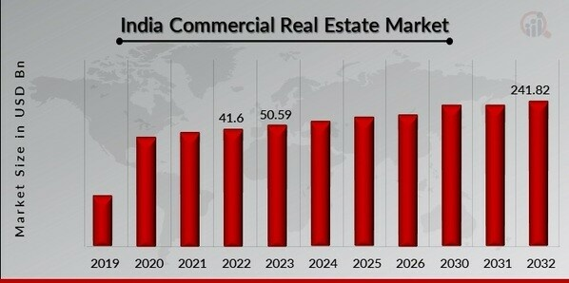
Market Size and Future forecast

Slide 5
The Economic Survey 2024-25 highlights a robust performance in India's real estate market. Here are some key points: RERA and GST: The Real Estate (Regulation and Development) Act (RERA) and Goods and Services Tax (GST) have brought transparency, protection against fraud, and timely project deliveries. Sales Growth: The residential real estate market saw an 11-year high in sales volume during the first half of 2024, with an 11% year-on-year growth in top cities. Future Demand: Housing demand in India is expected to reach 93 million units by 2036. REITs: The rise of Real Estate Investment Trusts (REITs) has positively impacted the commercial sector.

Slide 6
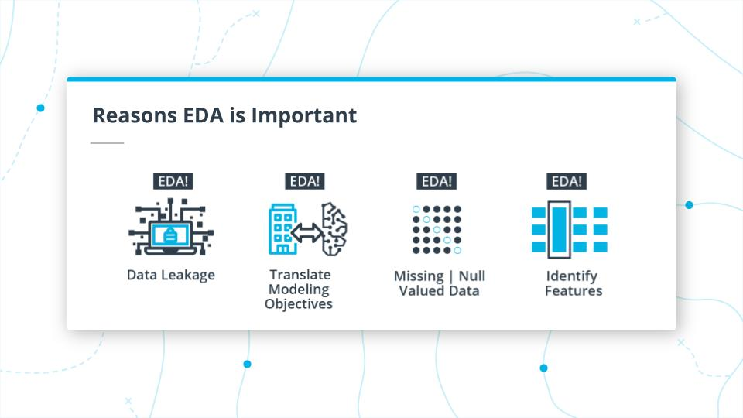
Importance Of EDA

Slide 7
Dataset Description The dataset comprises diverse parameters such as location, size, amenities, market trends, economic indicators, and historical transaction data. These variables contribute to the intricate web of pricing dynamics
Rows | Columns | Range | Data Types | Total
1460 | 80 | 0 to 1459 | Int 64 | 34
 |  |  | Float64 | 1
 |  |  | Objects | 45
 |  |  | 3 | 80

Slide 8
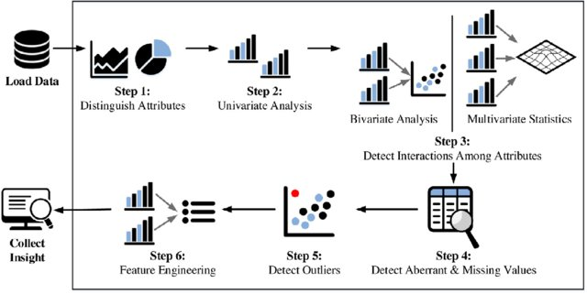
Steps Involved In EDA

Slide 9
Following steps taken for Data Cleaning
Handling missing values
Removing duplicates
Outlier detection and treatment
Data transformation (e.g., encoding categorical variables)
Dropping Duplicates
Data Describe

Slide 10

Univariate and Bivariate Analysis All steps incorporated in jupyter notebook
**Univariate Analysis**
**Bivariate Analysis**
Distribution of key numerical variables (price, size, bedrooms, etc.)
Histograms and box plots
Summary statistics (mean, median, standard deviation)
Relationship between price and size
Correlation matrix for numerical variables
Scatter plots and pair plots
Impact of categorical variables (location, type of house) on price

Slide 11



Multivariate Analysis & Geospatial Analysis
Multivariate Analysis
Multivariate data refers to datasets where each observation or sample point consists of multiple variables or features.
These variables can represent different aspects, characteristics, or measurements related to the observed phenomenon.
When dealing with three or more variables, the data is specifically categorized as multivariate.
In this case we have covered multivariate analysis of variables such as bedroom , lot area, sale prices etc.
Geospatial Analysis
Distribution of housing prices across different locations
Heatmaps and density maps
Insights from geographical trends

Slide 12
Feature -Engineering
Feature Engineering
“Feature engineering is the process of transforming raw data into features that are suitable for machine learning models”
Creating new meaningful features
Transforming skewed variables
Handling categorical variables (One-Hot Encoding, Label Encoding)
New Features Created
Price Per Square Foot.
Age of the Property
Recent Renovation Indicator
Bedroom Density (BedRoom to Size Ratio)
Handling categorical variables (One-Hot Encoding, Label Encoding)
Handled Categorical Variable Such As Neighborhood in the dataset and incorporated In the Jupyter Notebook.

Slide 13
Key Findings & Insights
Feature Engineering and Size Impact:
Summary of trends in housing prices
# For higher price per square feet there are less buyers compare to the lower one .
# lower is the property age higher is the price of the property
# There is a direct correlation between amenities and price of the property
Factors affecting house prices the most
# neighborhood , type of property , year of sale , amenities are factors that are affecting the price most
Anomalies and surprising discoveries
New features like price square feet , age of the property has helped for the better price analysis
Customer Preferences and Amenities
# customer preferences are ever evolving .
# amenities and price has the direct correlation
# customer feedback is important parameter for house property style and amenities
Market Trends and Historical Pricing
# sale price is keep on fluctuating throughout the various years of sale
# according to the market condition price also changes over the period of time

Slide 14
Conclusion & Next Steps
Exploratory Data Analysis (EDA) serves as the cornerstone of any data-driven project, playing a pivotal role in unraveling the complex patterns and insights hidden within datasets.
In the context of our real estate pricing project, EDA acts as the compass guiding us through the myriad variables that influence house valuations.
we gain a deeper understanding of the underlying dynamics in the real estate market, facilitating informed decision-making and strategic positioning of properties.
findings can guide decision-making In Real Market Conditions
Next steps- Predictive modeling, deeper insights, business applications
References
# https://www.geeksforgeeks.org
# https://medium.com/towards-data-science
# https://pytutorial.com

Slide 15




Thank you
“EDA is all about exploring data, finding anomalies, and gaining a deeper understanding of the underlying structure before performing more formal analyses.”
“The greatest value of a picture is when it forces us to notice what we never expected to see."

